Slide 1
Using Arrays in Matlab
Week 8
Day 29

Slide 2
Recap: Matlab Basics
Matlab Window
Command window: type interactive mode commands, echoes results of interactive commands and actions from script file
Current Folder window: shows currently active folder contents
Workspace window: shows currently defined variables and their values
Command history window: shows previous commands entered in Command window – can copy from here & paste into editor or command windows

Slide 3
Recap: Matlab Basics
Matlab Math Operations
Uses same algebraic operators as VBA & Excel: + - * / ^
Many built-in math functions:
Syntax: FunctionName(Arguments), same as VBA & Excel
See list of functions: type “help matlab\elfun” in Command window
Variable & Script file names
Must start with a letter
Can only use letters, numbers, and underscore ( _ )
NO SPACES

Slide 4
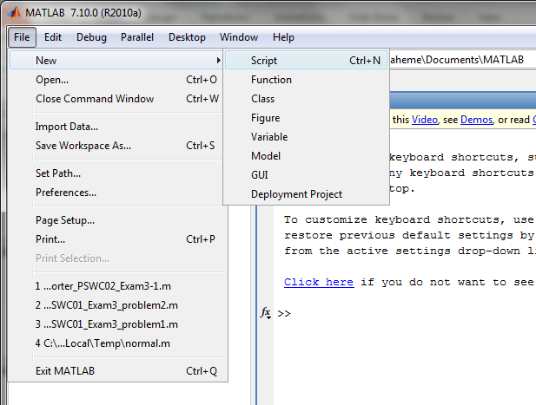
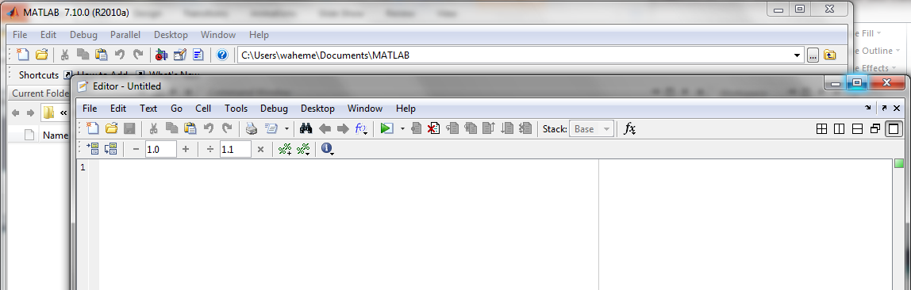
Using the Script Editor
File → New → Script
Script Editor Window

Slide 5
Recap: Simple Input and Output
INPUT
a=input(‘enter value of A’);
OUTPUT
disp(a)
Construct a string variable to make disp more useful
message=['the value of pi is ' num2str(pi)];
disp(message)

Slide 6
Array Math
Arrays in Matlab can be either a collection of numbers or a vector/matrix
Mathematical operations can be done either using the rules of vector/matrix mathematics or element-by-element (same mathematical operation on each element in the collection)

Slide 7
Array Basics
1D Arrays:
Row vectors : A=[1, 2, 3, 4]
Column vectors B=[1;2;3;4]
2D Arrays:
C=[1,2; 3,4] (this is a 2x2 array)
D=[1, 2, 3; 4, 5, 6; 7, 8, 9; 10, 11, 12] (4x3 array)
Accessing elements of arrays
A(1), B(1), C(2,1), D(2,4), etc.
Why does the difference between a row array/vector and column array/vector matter?!

Slide 8
Mathematics with Arrays in Matlab
Because Matlab does vector math!
Mathematical Operations
Matrix operations : * (multiplication), / (division), ^ (exponentiation)
Element-wise array operations: .* (multiplication), . / (division), . ^ (exponentiation)
The dot directly in front of the *, /, or ^ operators tells Matlab to treat the elements of an array as a collection of individual numbers rather than the elements of a single vector or matrix.

Slide 9
1-D Array Construction Examples
X=[ 1 2 3 6 8]; Y=X’ (transposed vector)
X(2:end); X(2:4); X=-2:3:10 (3 – step, 10 – max);
X=(0:0.1:1)*pi;
X=linspace(0,pi,11); (pi – last element, 11 – number of nodes)
X=linspace(0,pi); (100 – number of nodes - default)
X=logspace(0,2,20); (20 nodes evenly distributed from 10^0 to 10^2)

Slide 10
Useful Operations & Functions – 1D Vectors
X=[1 3 5 7 9];
Sum(X); prod(X); max(X); min(X); length(X);
Empty Array []. Useful to eliminate elements.
X(2:4)=[], as a result X is reduced to X=[1 9]

Slide 11
Using Functions with Arrays
In Matlab, the result of a function performed on an argument which is an array is an array of the same size as the argument
sqrt(X); exp(X); sin(X)…

Slide 12
Week 8 In-Class Exercise #1: Volume and surface area of sphere
Using arrays take user input for radius and calculate the volume and surface area of a sphere
Vol = 4/3 * pi * r^3
S_area = 4 * pi * r^2

